Slide 1
Evaluation and Credibility
How much should we believe in what was learned?
Branko Kavšek
branko.kavsek@upr.si
University of Primorska
Faculty for Mathematics, Natural Sceinces and Information Technology
Lectures in DM
Academic year 2018/19

Slide 2
Outline
Introduction
Classification with Train, Test,
and Validation sets
  Handling Unbalanced Data
  Parameter Tuning
Cross-validation
Comparing Data Mining Schemes
12th lecture
© Branko Kavšek, 2018/19
slide <number>

Slide 3
Introduction
How predictive is the model we learned?
Error on the training data is not a good indicator of performance on future data
  Q: Why?
  A: Because new data will probably not be exactly the same as the training data!
Overfitting – fitting the training data too precisely – usually leads to poor results on new data
12th lecture
© Branko Kavšek, 2018/19
slide <number>

Slide 4
Evaluation issues
Possible evaluation measures:
  Classification Accuracy
  Total cost/benefit – when different errors involve different costs
  Lift and ROC curves
  Error in numeric predictions
How reliable are the predicted results?
12th lecture
© Branko Kavšek, 2018/19
slide <number>

Slide 5
Classifier error rate
Natural performance measure for classification problems: error rate
  Success: instance’s class is predicted correctly
  Error: instance’s class is predicted incorrectly
  Error rate: proportion of errors made over the whole set of instances
Training set error rate: is way too optimistic!
  you can find patterns even in random data
12th lecture
© Branko Kavšek, 2018/19
slide <number>

Slide 6
Evaluation on “LARGE” data, 1
If many (thousands) of examples are available, including several hundred examples from each class, then how can we evaluate our classifier method?
12th lecture
© Branko Kavšek, 2018/19
slide <number>

Slide 7
Evaluation on “LARGE” data, 2
A simple evaluation is sufficient
  Randomly split data into training and test sets (usually 2/3 for train, 1/3 for test)
Build a classifier using the train set and evaluate it using the test set.
12th lecture
© Branko Kavšek, 2018/19
slide <number>

Slide 8
Classification Step 1:
Split data into train and test sets
THE PAST
Results Known
+
Training set
+
-
-
Data
+
Testing set
12th lecture
© Branko Kavšek, 2018/19
slide <number>

Slide 9
Classification Step 2:
Build a model on a training set
THE PAST
Results Known
+
Training set
+
-
-
Data
+
Model Builder
Testing set
12th lecture
© Branko Kavšek, 2018/19
slide <number>

Slide 10
Classification Step 3:
Evaluate on test set (Re-train?)
Results Known
+
Training set
+
-
-
Data
+
Model Builder
Evaluate
Predictions
+
-
+
-
Y
N
Testing set
12th lecture
© Branko Kavšek, 2018/19
slide <number>

Slide 11
Unbalanced data
Sometimes, classes have very unequal frequency
  Attrition prediction: 97% stay, 3% attrite (in a month)
  medical diagnosis: 90% healthy, 10% disease
  eCommerce: 99% don’t buy, 1% buy
  Security: >99.99% of Americans are not terrorists
Similar situation with multiple classes
Majority class classifier can be 97% correct,
but useless
12th lecture
© Branko Kavšek, 2018/19
slide <number>

Slide 12
Handling unbalanced data – how?
If we have two classes that are very unbalanced, then how can we evaluate our classifier method?
12th lecture
© Branko Kavšek, 2018/19
slide <number>

Slide 13
Balancing unbalanced data, 1
With two classes, a good approach is to build BALANCED train and test sets, and train model on a balanced set
  randomly select desired number of minority class instances
  add equal number of randomly selected
  majority class
How do we generalize “balancing” to multiple classes?
12th lecture
© Branko Kavšek, 2018/19
slide <number>

Slide 14
Balancing unbalanced data, 2
Generalize “balancing” to multiple classes
  Ensure that each class is represented with approximately equal proportions in train and test
12th lecture
© Branko Kavšek, 2018/19
slide <number>

Slide 15
A note on parameter tuning
It is important that the test data is not used
in any way to create the classifier
Some learning schemes operate in two stages:
  Stage 1: builds the basic structure
  Stage 2: optimizes parameter settings
The test data can’t be used for parameter tuning!
Proper procedure uses three sets: training data, validation data, and test data
  Validation data is used to optimize parameters
12th lecture
© Branko Kavšek, 2018/19
slide <number>

Slide 16
Making the most of the data
Once evaluation is complete, all the data can be used to build the final classifier
Generally, the larger the training data the better the classifier (but returns diminish)
The larger the test data the more accurate the error estimate
12th lecture
© Branko Kavšek, 2018/19
slide <number>

Slide 17
Classification: Train, Validation, Test split
Results Known
+
Model
Builder
+
Training set
-
-
Data
+
Evaluate
Model Builder
Predictions
+
-
+
-
Y
N
Validation set
+
-
+
-
Final Evaluation
Final Test Set
Final Model
12th lecture
© Branko Kavšek, 2018/19
slide <number>

Slide 18
*Predicting performance
Assume the estimated error rate is 25%. How close is this to the true error rate?
  Depends on the amount of test data
Prediction is just like tossing a biased (!) coin
  “Head” is a “success”, “tail” is an “error”
In statistics, a succession of independent events like this is called a Bernoulli process
Statistical theory provides us with confidence intervals for the true underlying proportion!
12th lecture
© Branko Kavšek, 2018/19
slide <number>

Slide 19
*Confidence intervals
We can say: p lies within a certain specified interval with a certain specified confidence
Example: S=750 successes in N=1000 trials
  Estimated success rate: 75%
  How close is this to true success rate p?
    Answer: with 80% confidence p∈[73.2,76.7]
Another example: S=75 and N=100
  Estimated success rate: 75%
  With 80% confidence p∈[69.1,80.1]
12th lecture
© Branko Kavšek, 2018/19
slide <number>

Slide 20

*Mean and variance (also Mod 7)
Mean and variance for a Bernoulli trial:
p, p(1–p)
Expected success rate f=S/N
Mean and variance for f : p, p (1–p)/N
For large enough N, f follows a Normal distribution
c% confidence interval [–z ≤ X ≤ z] for random variable with 0 mean is given by:
With a symmetric distribution:
12th lecture
© Branko Kavšek, 2018/19
slide <number>
Notes:
Standard Deviation = sqrt (p(1-p)/N)

Slide 21
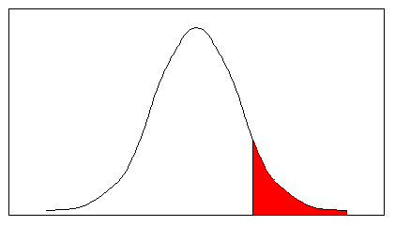
*Confidence limits
Confidence limits for the normal distribution with 0 mean and a variance of 1:
Thus:
To use this we have to reduce our random variable f to have 0 mean and unit variance
Pr[X ≥ z] | z
0.1% | 3.09
0.5% | 2.58
1% | 2.33
5% | 1.65
10% | 1.28
20% | 0.84
40% | 0.25
–1 0 1 1.65
12th lecture
© Branko Kavšek, 2018/19
slide <number>

Slide 22
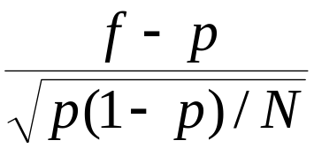
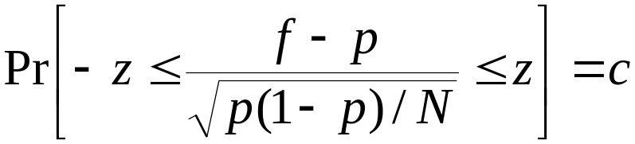
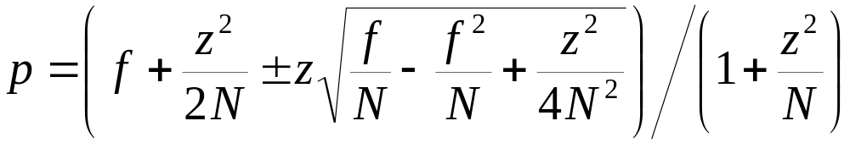
*Transforming f
Transformed value for f :
(i.e. subtract the mean and divide by the standard deviation)
Resulting equation:
Solving for p :
12th lecture
© Branko Kavšek, 2018/19
slide <number>
Notes:
Explain how we get p and what happens to C

Slide 23



*Examples
f = 75%, N = 1000, c = 80% (so that z = 1.28):
f = 75%, N = 100, c = 80% (so that z = 1.28):
Note that normal distribution assumption is only valid for large N (i.e. N > 100)
f = 75%, N = 10, c = 80% (so that z = 1.28):
(should be taken with a grain of salt)
12th lecture
© Branko Kavšek, 2018/19
slide <number>

Slide 24
Evaluation on “small” data, 1
The holdout method reserves a certain amount for testing and uses the remainder for training
  Usually: one third for testing, the rest for training
For “unbalanced” datasets, samples might not be representative
  Few or none instances of some classes
Stratified sample:
advanced version of balancing the data
  Make sure that each class is represented with approximately equal proportions in both subsets
12th lecture
© Branko Kavšek, 2018/19
slide <number>

Slide 25
Evaluation on “small” data, 2
What if we have a small data set?
The chosen 2/3 for training may not be representative.
The chosen 1/3 for testing may not be representative.
12th lecture
© Branko Kavšek, 2018/19
slide <number>

Slide 26
Repeated holdout method, 1
Holdout estimate can be made more reliable by repeating the process with different subsamples
  In each iteration, a certain proportion is randomly selected for training
  (possibly with stratification)
  The error rates on the different iterations are averaged to yield an overall error rate
This is called the repeated holdout method
12th lecture
© Branko Kavšek, 2018/19
slide <number>

Slide 27
Repeated holdout method, 2
Still not optimum: the different test sets overlap.
Can we prevent overlapping?
12th lecture
© Branko Kavšek, 2018/19
slide <number>

Slide 28
Cross-validation
Cross-validation avoids overlapping test sets
  First step: data is split into k subsets of equal size
  Second step: each subset in turn is used for testing and the remainder for training
This is called k-fold cross-validation
Often the subsets are stratified before the cross-validation is performed
The error estimates are averaged to yield an overall error estimate
12th lecture
© Branko Kavšek, 2018/19
slide <number>

Slide 29
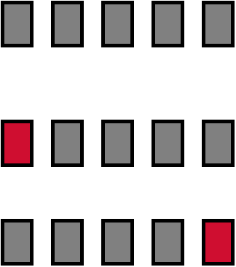
Cross-validation example:
Break up data into groups of the same size
Hold aside one group for testing and use the rest to build the model
Test
Repeat
12th lecture
© Branko Kavšek, 2018/19
slide <number>

Slide 30
More on cross-validation
Standard method for evaluation:
stratified ten-fold cross-validation
Why ten? Extensive experiments have shown that this is the best choice to get an accurate estimate
Stratification reduces the estimate’s variance
Even better: repeated stratified cross-validation
  E.g. ten-fold cross-validation is repeated ten times and results are averaged (reduces the variance)
12th lecture
© Branko Kavšek, 2018/19
slide <number>

Slide 31
Leave-One-Out cross-validation
Leave-One-Out:
a particular form of cross-validation:
  Set number of folds to number of training instances
  I.e., for n training instances, build classifier n times
Makes best use of the data
Involves no random subsampling
Very computationally expensive(exception: NN)
12th lecture
© Branko Kavšek, 2018/19
slide <number>

Slide 32
Leave-One-Out-CV and stratification
Disadvantage of Leave-One-Out-CV:
stratification is not possible
  It guarantees a non-stratified sample because there is only one instance in the test set!
Extreme example:
random dataset split equally into two classes
  Best inducer predicts majority class
  50% accuracy on fresh data
  Leave-One-Out-CV estimate is 100% error!
12th lecture
© Branko Kavšek, 2018/19
slide <number>

Slide 33

*The bootstrap
CV uses sampling without replacement
  The same instance, once selected, can not be selected again for a particular training/test set
The bootstrap uses sampling with replacement to form the training set
  Sample a dataset of n instances n times with replacement to form a new dataset
  of n instances
  Use this data as the training set
  Use the instances from the original
  dataset that don’t occur in the new
  training set for testing
12th lecture
© Branko Kavšek, 2018/19
slide <number>

Slide 34
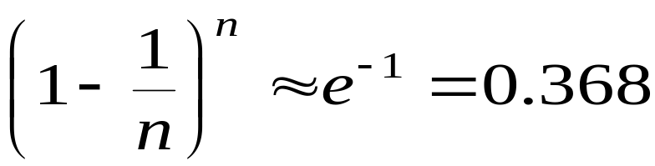
*The 0.632 bootstrap
Also called the 0.632 bootstrap
  A particular instance has a probability of 1–1/n of not being picked
  Thus its probability of ending up in the test data is:
  This means the training data will contain approximately 63.2% of the instances
12th lecture
© Branko Kavšek, 2018/19
slide <number>

Slide 35
*Estimating error with the bootstrap
The error estimate on the test data will be very pessimistic
  Trained on just ~63% of the instances
Therefore, combine it with the resubstitution error:
The resubstitution error gets less weight than the error on the test data
Repeat process several times with different replacement samples; average the results
12th lecture
© Branko Kavšek, 2018/19
slide <number>

Slide 36
*More on the bootstrap
Probably the best way of estimating performance for very small datasets
However, it has some problems
  Consider the random dataset from above
  A perfect memorizer will achieve
  0% resubstitution error and
  ~50% error on test data
  Bootstrap estimate for this classifier:
  True expected error: 50%
12th lecture
© Branko Kavšek, 2018/19
slide <number>

Slide 37
Comparing data mining schemes
Frequent situation: we want to know which one of two learning schemes performs better
  Note: this is domain dependent!
Obvious way: compare 10-fold CV estimates
  Problem: variance in estimate
Variance can be reduced using repeated CV
However, we still don’t know whether the results are reliable
12th lecture
© Branko Kavšek, 2018/19
slide <number>

Slide 38
Significance tests
Significance tests tell us how confident we can be that there really is a difference
Null hypothesis: there is no “real” difference
Alternative hypothesis: there is a difference
A significance test measures how much evidence there is in favor of rejecting the null hypothesis
Let’s say we are using 10 times 10-fold CV
Then we want to know whether the two means of the 10 CV estimates are significantly different
  Student’s paired t-test tells us whether the means of two samples are significantly different
12th lecture
© Branko Kavšek, 2018/19
slide <number>

Slide 39
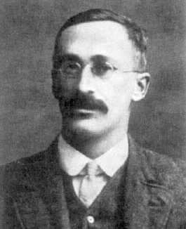
*Paired t-test
Student’s t-test tells whether the means of two samples are significantly different
Take individual samples from the set of all possible cross-validation estimates
Use a paired t-test because the individual samples are paired
  The same CV is applied twice
William Gosset
Born: 1876 in Canterbury; Died: 1937 in Beaconsfield, England.
Obtained a post as a chemist in the Guinness brewery in Dublin in 1899. Invented the t-test to handle small samples for quality control in brewing. Wrote under the name "Student".
12th lecture
© Branko Kavšek, 2018/19
slide <number>

Slide 40
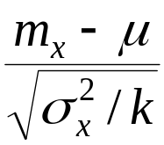
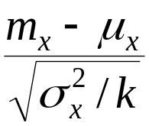
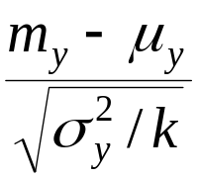
*Distribution of the means
x₁ x₂ … x_{k} and y₁ y₂ … y_{k} are the 2k samples for a k-fold CV
m_{x} and m_{y} are the means
With enough samples, the mean of a set of independent samples is normally distributed
Estimated variances of the means are σ_{x}²/k and σ_{y}²/k
If μ_{x} and μ_{y} are the true means then
are approximately normally distributed with
mean 0 and variance 1
12th lecture
© Branko Kavšek, 2018/19
slide <number>

Slide 41
*Student’s distribution
With small samples (k < 100) the mean follows Student’s distribution with k–1 degrees of freedom
Confidence limits:
9 degrees of freedom normal distribution
Pr[X ≥ z] | z
0.1% | 4.30
0.5% | 3.25
1% | 2.82
5% | 1.83
10% | 1.38
20% | 0.88
Pr[X ≥ z] | z
0.1% | 3.09
0.5% | 2.58
1% | 2.33
5% | 1.65
10% | 1.28
20% | 0.84
12th lecture
© Branko Kavšek, 2018/19
slide <number>

Slide 42
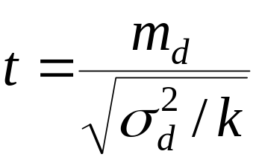
*Distribution of the differences
Let m_{d} = m_{x} – m_{y}
The difference of the means (m_{d}) also has a Student’s distribution with k–1 degrees of freedom
Let σ_{d}² be the variance of the difference
The standardized version of m_{d} is called the t-statistic:
We use t to perform the t-test
12th lecture
© Branko Kavšek, 2018/19
slide <number>

Slide 43
*Performing the test
Fix a significance level α
  If a difference is significant at the α% level,
  there is a (100-α)% chance that there really is a difference
Divide the significance level by two because the test is two-tailed
  I.e. the true difference can be +ve or –ve
Look up the value for z that corresponds to α/2
If t ≤ –z or t ≥ z then the difference is significant
  I.e. the null hypothesis can be rejected
12th lecture
© Branko Kavšek, 2018/19
slide <number>

Slide 44
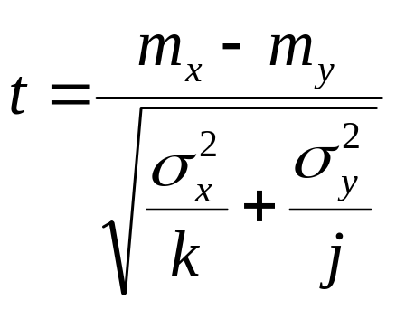
Unpaired observations
If the CV estimates are from different randomizations, they are no longer paired
  (or maybe we used k-fold CV for one scheme, and j-fold CV for the other one)
Then we have to use an un paired t-test with min(k, j) – 1 degrees of freedom
The t-statistic becomes:
12th lecture
© Branko Kavšek, 2018/19
slide <number>

Slide 45
*Interpreting the result
All our cross-validation estimates are based on the same dataset
Hence the test only tells us whether a complete
k-fold CV for this dataset would show a difference
  Complete k-fold CV generates all possible partitions of the data into k folds and averages the results
Ideally, should use a different dataset sample for each of the k-fold CV estimates used in the test to judge performance across different training sets
12th lecture
© Branko Kavšek, 2018/19
slide <number>

Slide 46
T-statistic many uses
Looking ahead, we will come back to use of T-statistic for gene filtering in later modules
12th lecture
© Branko Kavšek, 2018/19
slide <number>

Slide 47
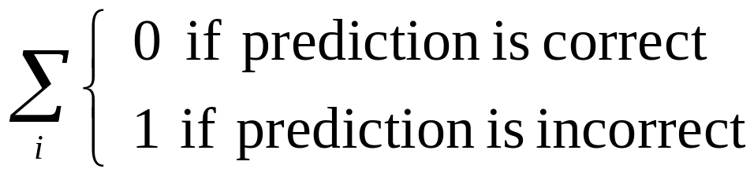
*Predicting probabilities
Performance measure so far: success rate
Also called 0-1 loss function:
Most classifiers produces class probabilities
Depending on the application, we might want to check the accuracy of the probability estimates
0-1 loss is not the right thing to use in those cases
12th lecture
© Branko Kavšek, 2018/19
slide <number>

Slide 48
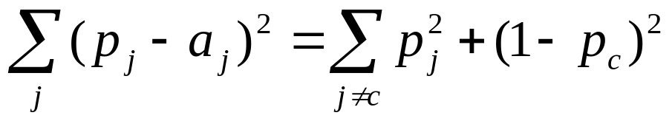
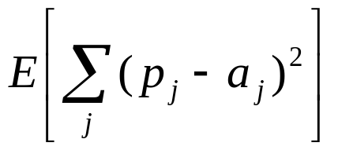
*Quadratic loss function
p₁ … p_{k} are probability estimates for an instance
c is the index of the instance’s actual class
a₁ … a_{k} = 0, except for a_{c} which is 1
Quadratic loss is:
Want to minimize
Can show that this is minimized when p_{j} = p_{j}*, the true probabilities
12th lecture
© Branko Kavšek, 2018/19
slide <number>

Slide 49
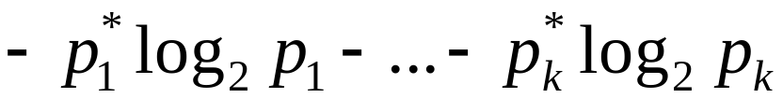
*Informational loss function
The informational loss function is –log(p_{c}),
where c is the index of the instance’s actual class
Number of bits required to communicate the actual class
Let p₁* … p_{k}* be the true class probabilities
Then the expected value for the loss function is:
Justification: minimized when p_{j} = p_{j}*
Difficulty: zero-frequency problem
12th lecture
© Branko Kavšek, 2018/19
slide <number>

Slide 50
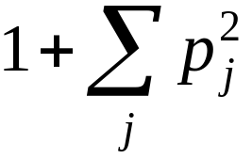
*Discussion
Which loss function to choose?
  Both encourage honesty
  Quadratic loss function takes into account all class probability estimates for an instance
  Informational loss focuses only on the probability estimate for the actual class
  Quadratic loss is bounded:
  it can never exceed 2
  Informational loss can be infinite
Informational loss is related to
MDL principle
12th lecture
© Branko Kavšek, 2018/19
slide <number>

Slide 51
Evaluation Summary:
Use Train, Test, Validation sets for
“LARGE” data
Balance “un-balanced” data
Use Cross-validation for small data
Don’t use test data for parameter tuning – use separate validation data
Most Important: Avoid Overfitting
12th lecture
© Branko Kavšek, 2018/19
slide <number>

